Slide 1

COMPUTER NETWORKING
LAB 7

Slide 2
Ethernet &VLAN

Slide 3
OBJECTIVES
Manually set the line rate on an interface.
Configuration of manual mode link aggregation. Configuration of link aggregation using static LACP mode.
Management of the priority of interfaces in static LACP mode.

Slide 4
LACP
LINK AGGREGATION CONTROL PROTOCOL
The main purpose of LACP is to automatically add/delete individual links to the aggregate bundle, while adding new links and also after recovering from link failures.
LACP can monitor to verify if all the links are connected to the right group.
Basically, LACP helps automate the configuration and maintenance of LAG’s

Slide 5
LACP
The concepts in LACP include:
LACP system priority
LACP system priorities determine the sequence in which devices at two ends of an Eth-Trunk select active interfaces to join a LAG. In order for a LAG to be established, both devices must select the same interfaces as active interfaces. To achieve this, one device (with a higher priority) is responsible for selecting the active interfaces. The other device (with a lower priority) then selects the same interfaces as active interfaces.
In priority comparisons, numerically lower values have higher priority.

Slide 6
LACP
The concepts in LACP include:
LACP interface priority
LACP interface priorities affect which interfaces of an Eth-Trunk are selected as active interfaces. A smaller numerical value represents a higher priority. The interfaces with the highest LACP interface priority become active interfaces.

Slide 7
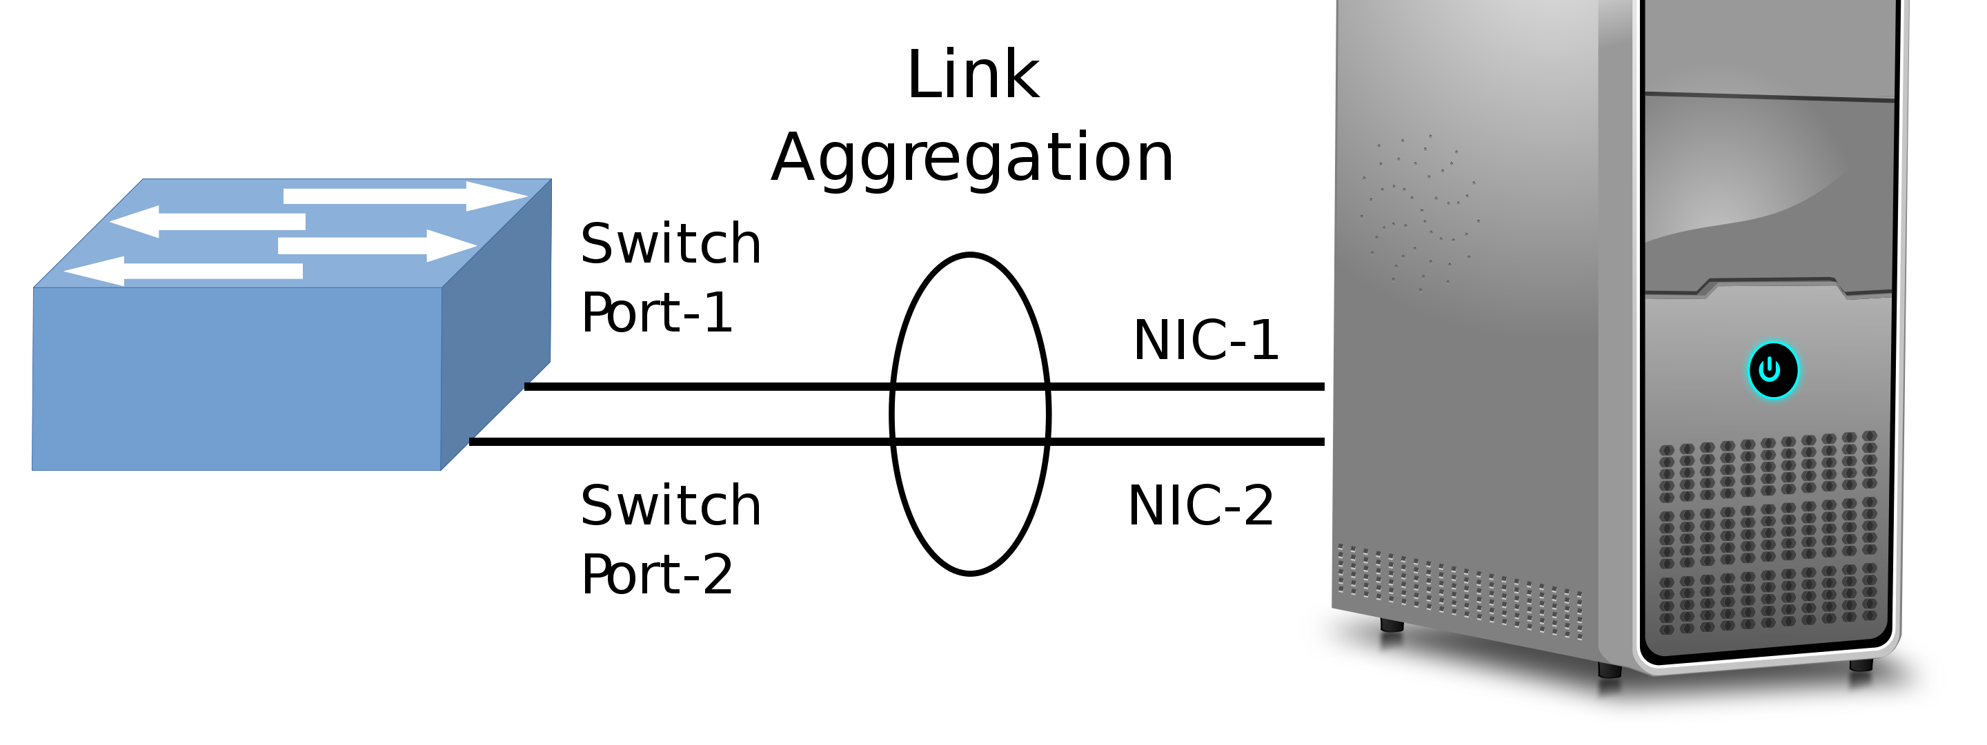
LACP Illustration 1:
Link aggregation between a switch and a server

Slide 8
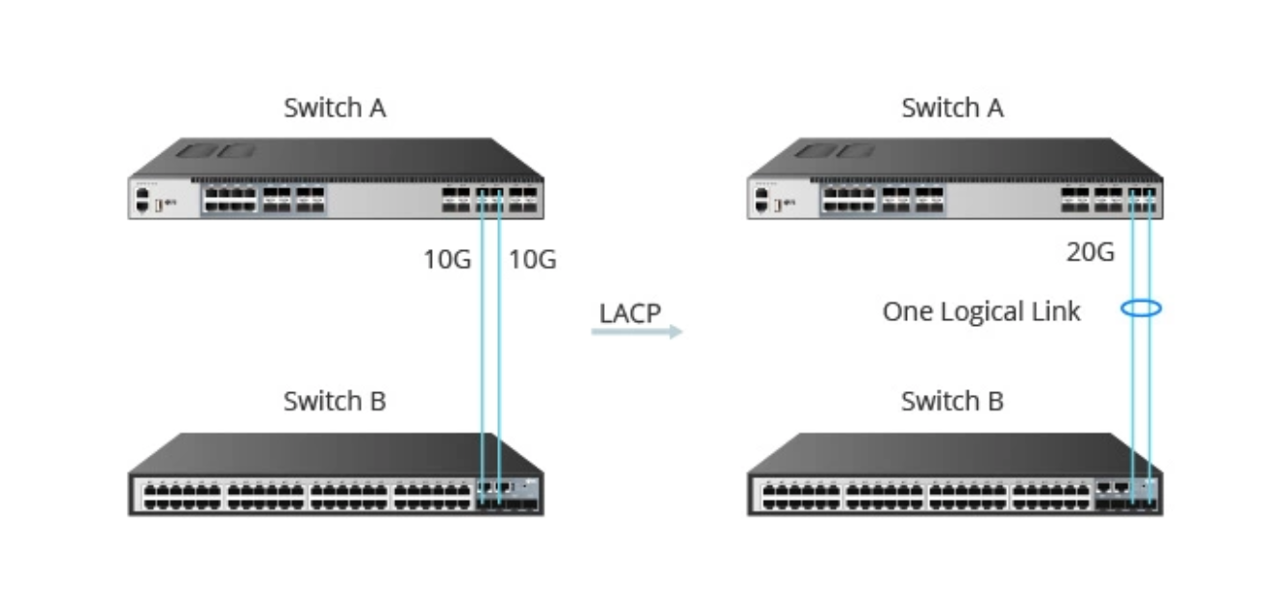
LACP Illustration 2:
Link aggregation between a switch A AND B

Slide 9
LACP
Hands on configuration for (LACP)

Slide 10
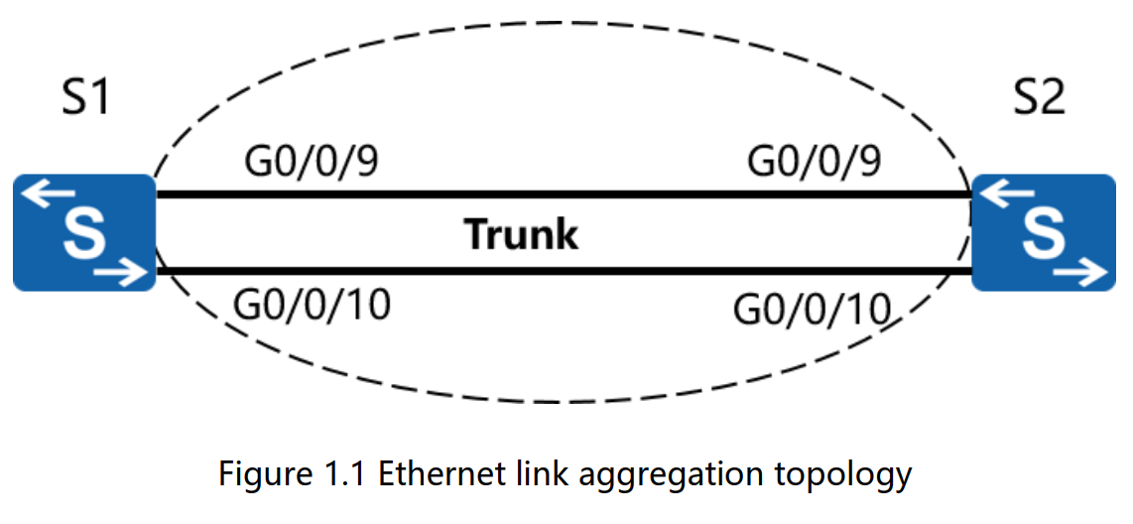
Topology

Slide 11
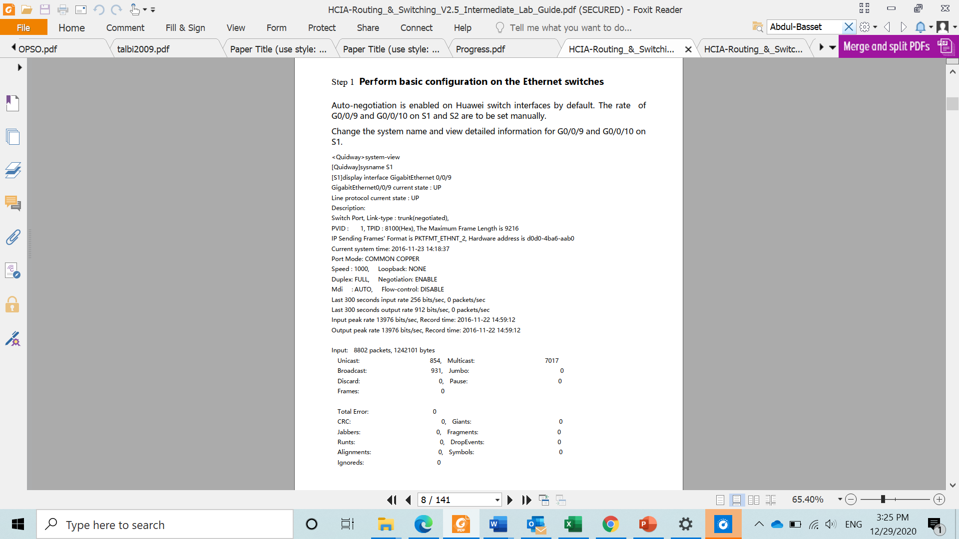
Perform basic configuration on the Ethernet switches
Auto-negotiation is enabled on Huawei switch interfaces by default.
The rate if G0/0/9 and G0/0/10 on D1 are to be set manually.
Change the system name and view detailed information for G0/0/9 and G0/0/10 on S1

Slide 12
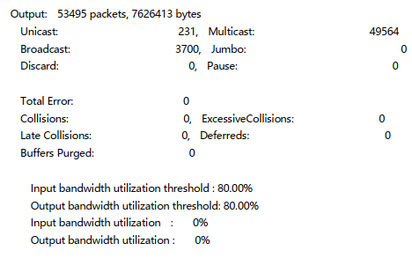
Perform basic configuration on the Ethernet switches

Slide 13
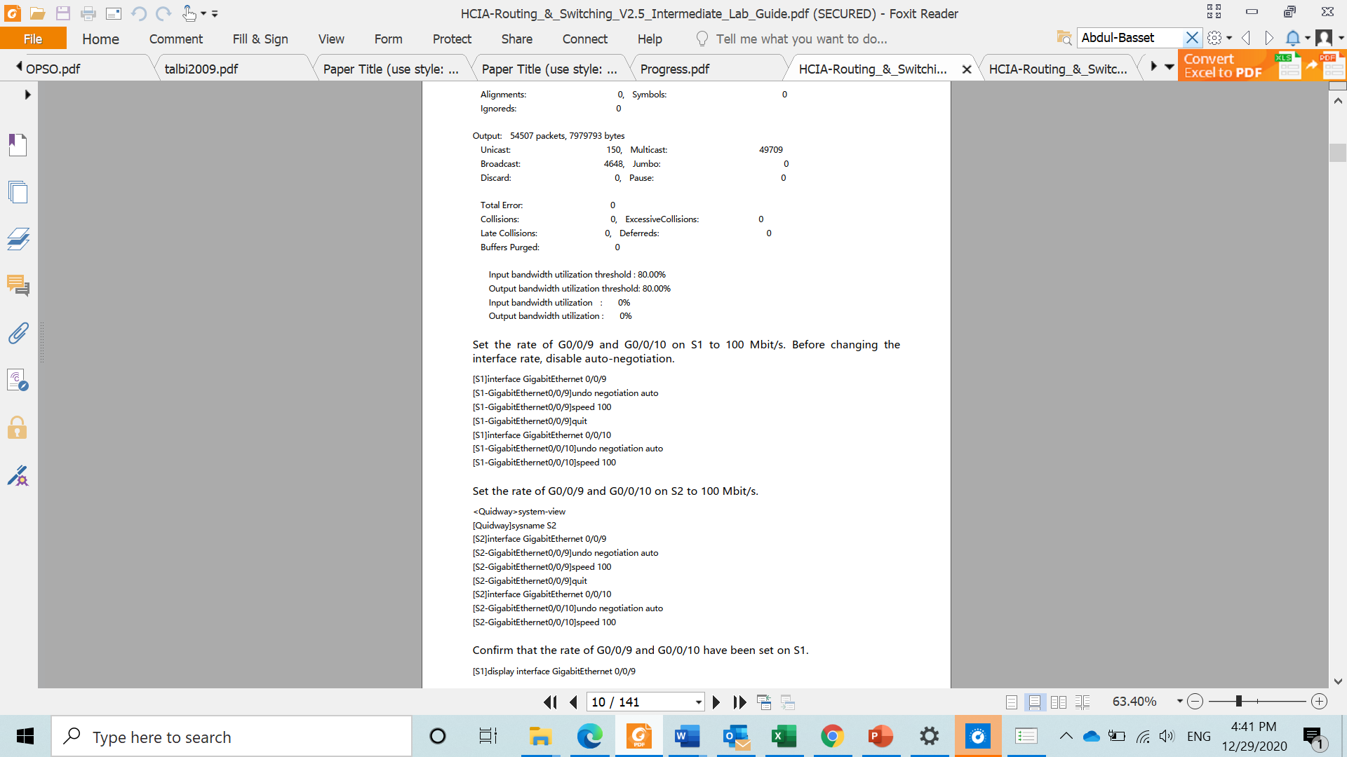
Perform basic configuration on the Ethernet switches
Set the rate of G 0/0/9 and G 0/0/10 on S1 to 100 Mbit/s. before changing the interface rate,
Disable auto-negotiation.
Set the rate of G 0/0/9 and G 0/0/10 on S2 to 100 Mbit/d.
Confirm that the rate of G 0/0/9 and G 0/0/10 have been set on S1.

Slide 14
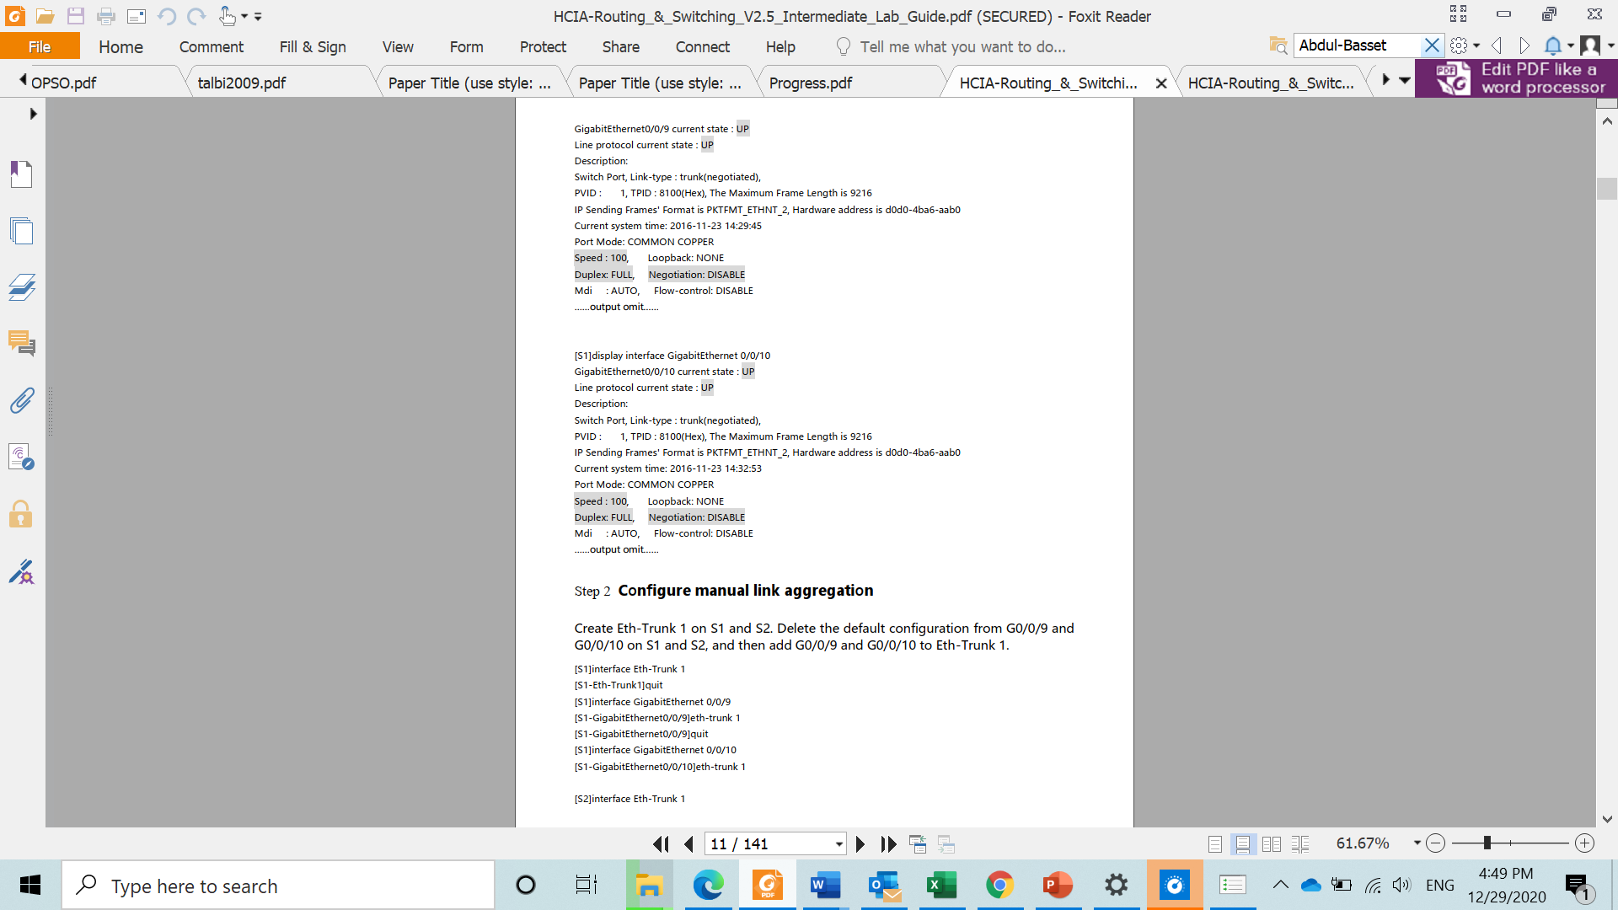
Perform basic configuration on the Ethernet switches

Slide 15
Perform basic configuration on the Ethernet switches

Slide 16
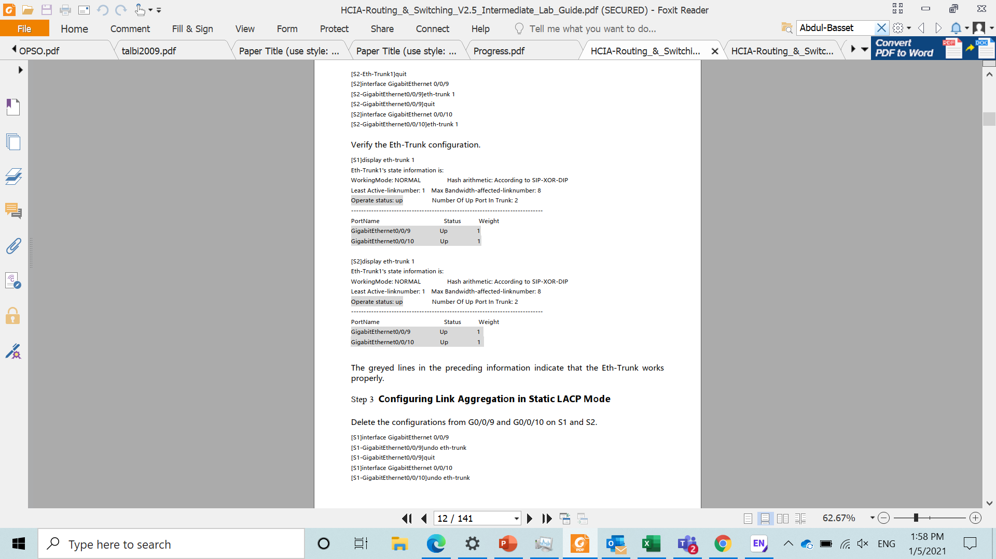
Configure manual link aggregation
Create Eth-Trunk 1 on S1 and S2
Delete the default configuration from G0/0/9 and G0/0/10 on S1 and S2,
Add G0/0/9 and G0/0/10 to Eth-Trunk1.

Slide 17
Verify the Eth-Trunk configuration

Slide 18
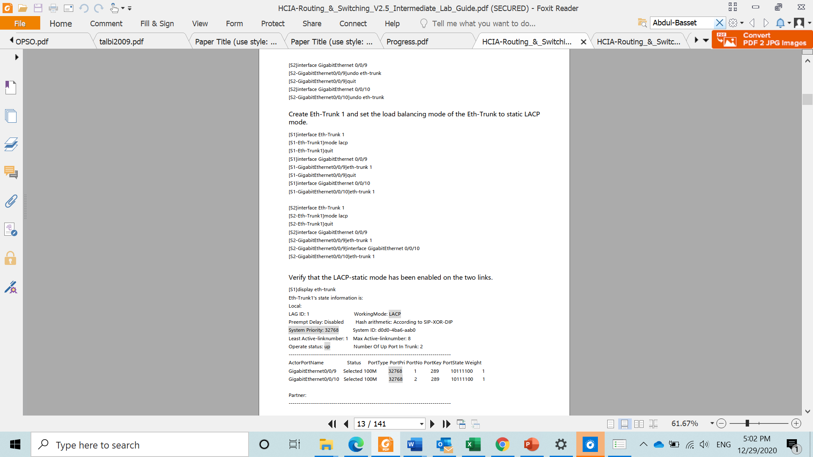
Configure link aggregation in static LACP mode
Delete the configurations from G0/0/9 and G 0/0/10 on S1 and S2 Eth-Trunk 1 on S1 and S2

Slide 19
Configure link aggregation in static LACP mode
Create Eth-Trunk 1 and set the loads balancing mode of the Eth-Trunk to static LACP mode.

Slide 20
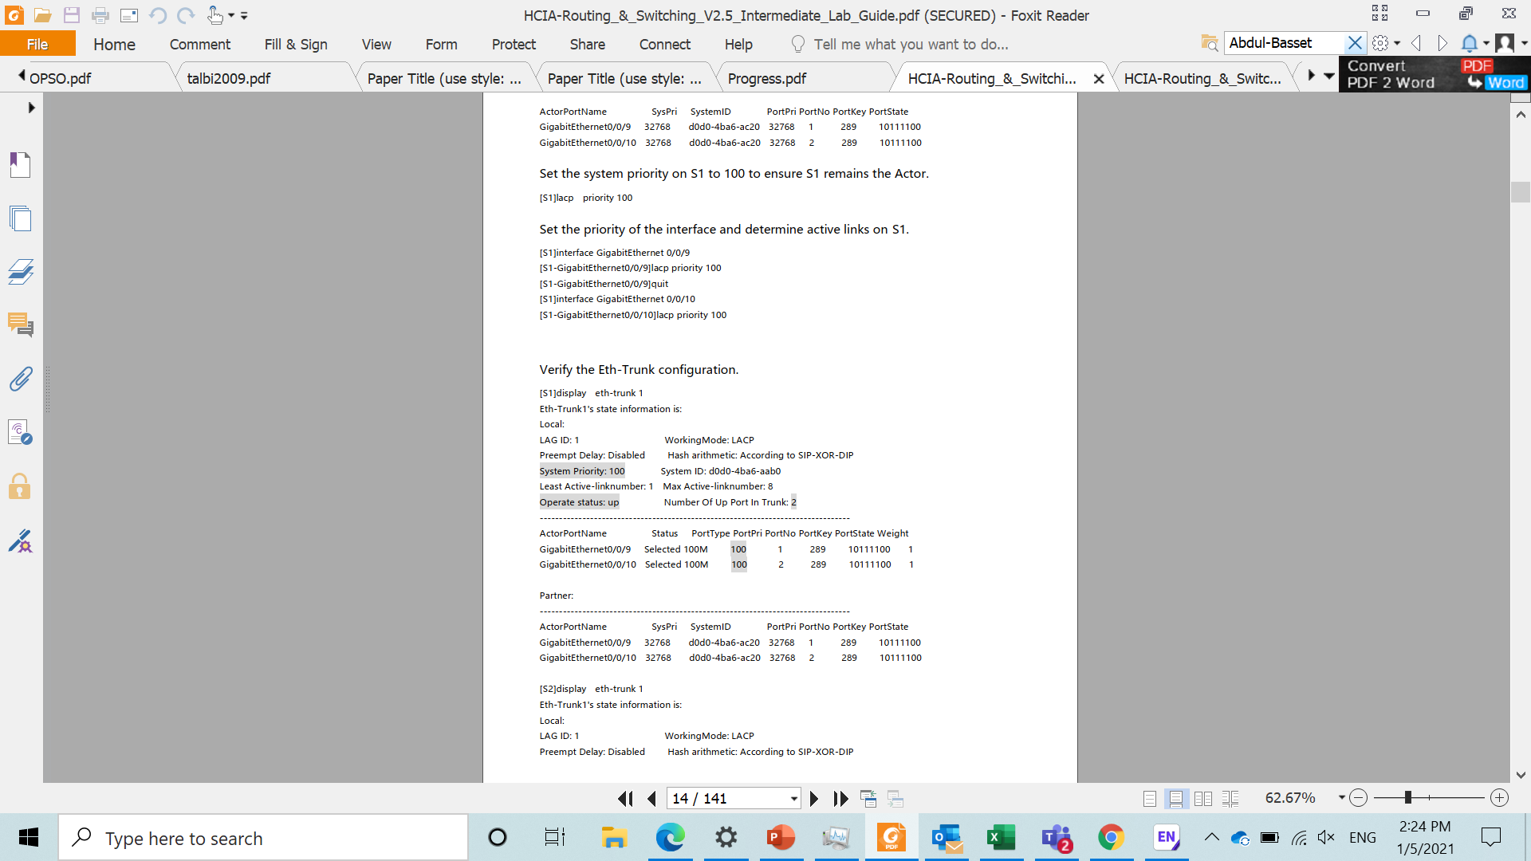
Configure link aggregation in static LACP mode
Verify that the LACP-static mode has been enabled on the two links

Slide 21
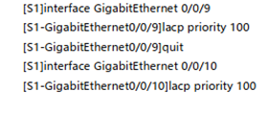
Configure link aggregation in static LACP mode
Set the system priority on S1 to 100 to ensure S1 remains the actor.
Set the priority of the interface and determine active links on S1.

Slide 22
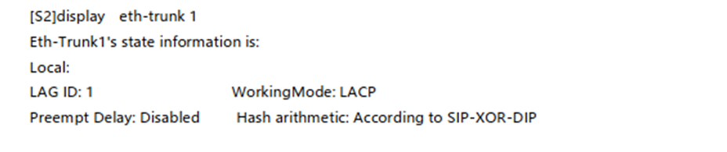
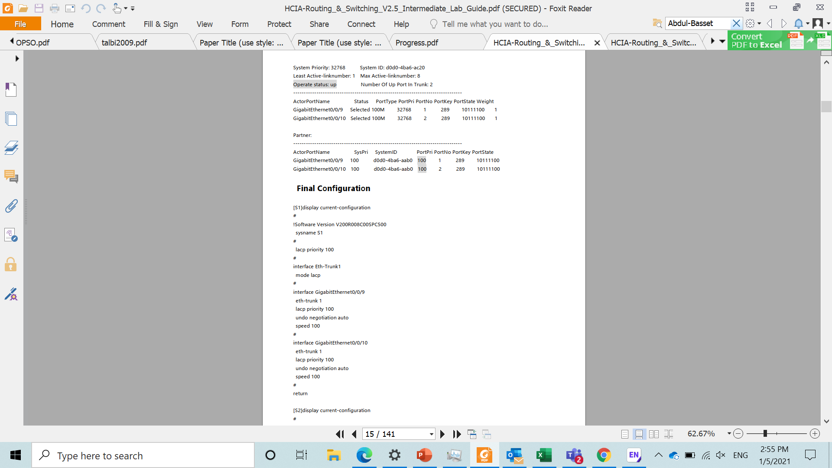
Verify the Eth-Trunk configuration

Slide 23
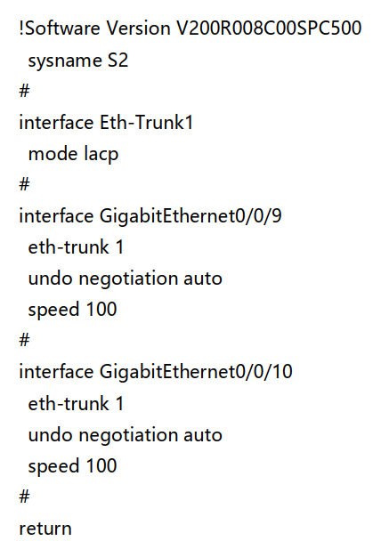
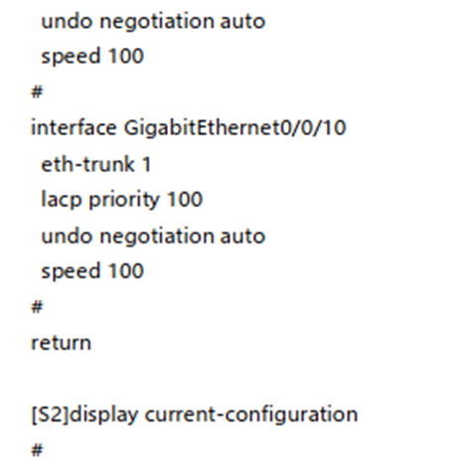
Final configuration

Slide 24
Thank you

